Slide 1

neoclassical.ai
The Game of Life
Conway and Nature
Notes:
Hi. Welcome to this episode of Emergent Nature.
My name is J Mark Morris. I go by Mark.

Slide 2
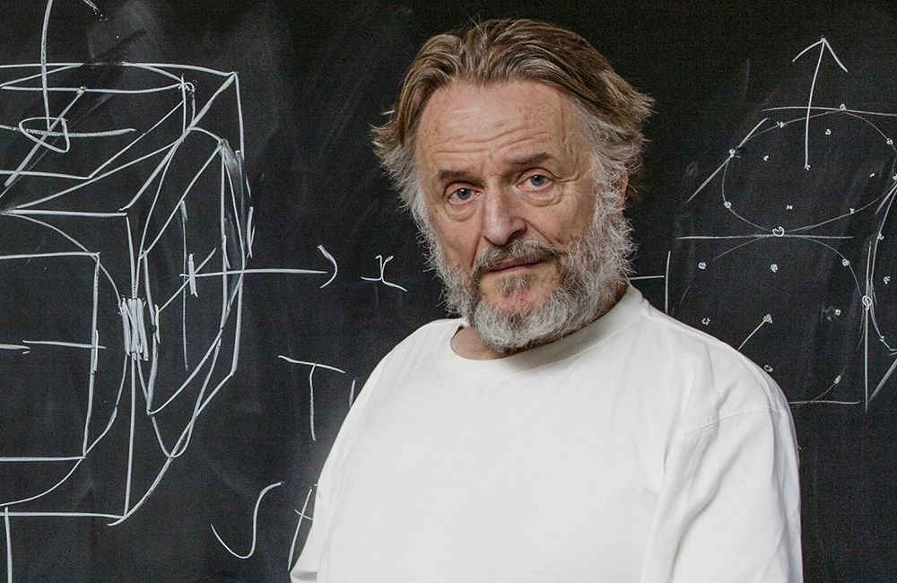
The Game of Life is a cellular automaton devised by the British mathematician John Horton Conway in 1970.
John Horton Conway FRS (26 December 1937 – 11 April 2020)
src: quanta and wikipedia

Slide 3
Universe
Rules
Grid
Initial State — 0
Evolution — 1
Evolution — N
Conway’s Game of Life Universe
Classically, the Game of Life plays out in an infinite, two-dimensional orthogonal grid of square cells.
Each cell is in one of two possible states, live or dead.
One meta player interacts by creating an initial configuration
Time moves forward only in discrete time steps.
The evolution is determined by the initial grid state, requiring no further input.
Meta player(s) may passively observe the initial configuration and how the grid evolves.
src: wikipedia, edited by JMM

Slide 4
Universe
Rules
Grid
Initial State — 0
Evolution — 1
Evolution — 2
Conway’s Game of LIfe Rules
Every cell interacts with its eight surrounding neighbors.
At each time step, the following transitions occur:
Any live cell with fewer than two live neighbors dies, as if by underpopulation.
Any live cell with two or three live neighbors lives on to the next evolution step.
Any live cell with more than three live neighbors dies, as if by overpopulation.
Any dead cell with exactly three live neighbors becomes a live cell, as if by reproduction.
The first evolution step is created by applying the rules to every cell in the initial grid.
The rules are applied each time step to create a new evolution step. src: wikipedia, edited by JMM

Slide 5
Conway’s Cell Life State Diagram
{0,1,2, 4,5,6,7,8}
{2,3}
dead
live
{3}
{0,1, 4,5,6,7,8}

Slide 6
The Glider
Grid
Initial State — 0
Evolution — 1
Evolution — 2
Evolution — 3
Evolution — 4
Evolution — 5
Evolution — 6

Slide 7
Aspects of Conway’s Game of Life
Consider each glider as an assembly of live cells.
The glider assembly appears to live on, moving upon an infinite empty grid.
Yet the cells in each glider are ephemeral with brief lifetimes of a few time steps.
The assembly of cells self replicates, via an ever-changing set of cells.
Individual cells have provenance only during their lifetime.
In Conway’s life, provenance means a life exists in one and only one cell for their lifetime, whether it is one tick, many ticks, or forever.
Let’s label the cells with the evolution step in which they were born...

Slide 8
The Glider with Evolutionary Step Lineage
Grid
Initial State — 0
Evolution — 1
Evolution — 2
 |  | 0
 |  |  | 0
 | 0 | 0 | 0
 | 1 |  | 0
 |  | 0 | 0
 |  | 1
 |  |  | 0
 | 2 |  | 0
 |  | 1 | 2
Evolution — 3
Evolution — 4
Evolution — 5
Evolution — 6
 |  | 3
 |  |  | 0 | 3
 |  | 1 | 2
 |  |  | 4
 |  |  |  | 3
 |  | 1 | 2 | 4
 |  | 5 |  | 3
 |  |  | 2 | 4
 |  |  | 5
 |  |  |  | 3
 |  | 6 |  | 4
 |  |  | 5 | 6

Slide 9
A Gosper's glider gun creating gliders
Wikipedia

Slide 10
The Game of Life on the surface of a toroidal trefoil knot Wikipedia

Slide 11
Life Differential : Conway v. Nature
Aspect | Conway | Nature
Spatial Domain | 2D cellular grid of states | Continuous 3D Euclidean space
Temporal Domain | Forward moving discrete time steps | Forward moving continuous linear time
Origin story and initial conditions. | A meta player initiates the life by establishing an initial pattern to launch the game. | Point potentials are indestructible and have no origin or death rule. There are no known initial conditions of the universe.
Evolution and Emergence | Discrete evolution and emergence from stepwise evolution rules. | Continuous evolution and emergence from continuous evolution laws of action.
Evolution Equation | Discrete state transition of entire grid based upon a ruleset about local (neighboring) population. | All point potentials maintain a relationship between each other and themselves. Action depends on location (x,y,z,t) and velocity for both emitter and receiver. Net action is determined by superposition.
Provenance | From a cell perspective there is birth, ongoing life, and death. From an assembly perspective there can be ongoing ”life”. | Each point potential follows a continuous path through Euclidean time and space. The path history includes the path inside assemblies and through reactions.

Slide 12
Thank You
Questions?

